Slide 1

Sync+ 2.0
CX727–Desay_EESE&CVPP parts
China EESE&CVPP
Updated on 2022-05-09
Desired Outcome
Awareness
Decision
Escalation Help
Think
Point of view
Plan to Implement
Implement

Slide 2
{R11 PRO HF4} Software overall status {yellow}
Software key info
  Refer SWAD for the details:
    MCU version:20220325_415_PRO
    SoC version:20220430_0680_CF15_R11.PRO.HF4_Debug
    Verification scope and method:
    {Full verification} executed with pass rate 98.03%, 5P1 and 70P2 issues found and not fixed. Refer test report for detail.
Highlights listed below:
    Release Note– refer slide 3
    Open P1 issue list with risk evaluation – refer slide 4
    Open P2 issue list with risk evaluation – refer slide 5
    Open AMIS issue list with risk evaluation – refer slide 6
    Performance Status– refer slide 7/8
    OTA Status– refer slide 9
Notes:
Add P1 weekly burn down chart

Slide 3
{R11 PRO HF4} Release Note
Key | Summary | Priority | AIMS# | Remark
APIMCIS-29328 | CX727 R档切换P档无法进入launcher | Immediate Gating |  | Approval
APIMCIS-21852 | 【必现】启动后Launcher界面弹出：“”设备不支持“的提示，随后自动消失 | Gating |  | Done
APIMCIS-29154 | [CX727][偶现][System Performance]挂R档后屏幕卡死休眠后恢复 | Immediate Gating |  | Approval
 | USB产线诊断时发送播放USB指令喇叭没有幅值 |  |  | 在R11 HF3 工程模式里解决DESAY 工厂产线问题的
 | U554配置FNV2 |  |  | U554 版本编译集成时用到的配置信息，不是代码提交信息。需要在Release Note里面删除。
Notes:
Add P1 weekly burn down chart

Slide 4
{R11 PRO HF4} Open P1 issue list with risk evaluation
Key | Summary | Priority | AIMS# | Remark
APIMCIS-27979 | [CX727][偶现][客诉问题][Account]账号校验与音源恢复顺序不固定 | Immediate Gating |  | 问题原因：随心听启动顺序比账号早，在随心听恢复播放之前，无法获取账号的真实登录状态。如果重启之前账号是登录状态，随心听缓存了登录状态，重启后随心听认为账号仍然为登录状态，所以继续播放了。此问题依赖账号的启动时序 发生概率：50% 恢复机制：NA 风险评估：L
APIMCIS-28706 | [CX727][客诉问题]从地下车库出来GPS要1-2分钟才能找到信号 | Immediate Gating |  | 问题原因：同CLM-346问题，从车库驶出2-3分钟无信号。经分析log属GPS信号弱。 发生概率：偶现一次 复现次数： -实车复现：压测50次未复现； -台架复现：5台样机屏蔽箱压测100次（各20次），拿出箱外5S内即可恢复信号；插拔GPS天线，5S内也可恢复信号 恢复机制：自动恢复 风险评估：问题出现概率低，和当时GPS环境有关，评估低风险
APIMCIS-28708 | [CX727][客户抱怨]空调控制操作不方便 | Immediate Gating |  | 问题原因：目前是按照需求实施，HMI团队lead评估修改 发生概率：100% 恢复机制：NA 风险评估：L
APIMCIS-28046 | [CX727][客诉问题]售后反馈车辆音响发出咣咣爆破音 | Immediate Gating |  | 问题原因：从视频上看，调节音量时喇叭有砰砰声发出，对于外置功放车，调节音量IVI只负责发送CAN信号出去，没有对声音做任何处理，需要外置功放支持分析。 发生概率：NA 恢复机制：NA 风险评估：L
APIMCIS-28400 | [CX727][客诉问题]车机Tab内部页面切换慢，如随心听，Setting等 | Immediate Gating |  | 问题原因：目前tap切换方案满足现在的align好的设计和性能状态。暂无好的优化解决方案，建议保持现状 发生概率：100% 恢复机制： 风险评估：L
Notes:
Add P1 weekly burn down chart

Slide 5

{R11 PRO HF4} Open P2 issue list with risk evaluation
Gating | 计数项:Status
Awaiting implementation | 9
In Progress | 35
Reopened | 3
Test | 20
To Do | 3
总计 | 70
CX727 R11版本计划修复89pcs，实际修复88pcs
Notes:
Add P1 weekly burn down chart

Slide 6

{R11 PRO HF4} Open AIMS issue list with risk evaluation
AIMS | 计数项:Status
In Progress | 3
Reopened | 2
Test | 4
总计 | 9
Notes:
Add P1 weekly burn down chart

Slide 7
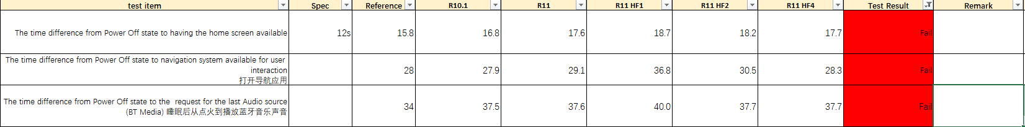
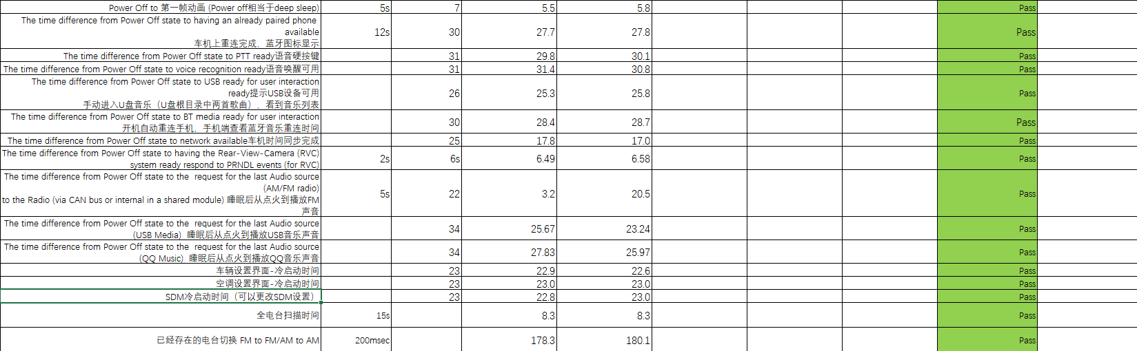
{R11 PRO HF4} 性能测试状态
Notes:
Add P1 weekly burn down chart

Slide 8
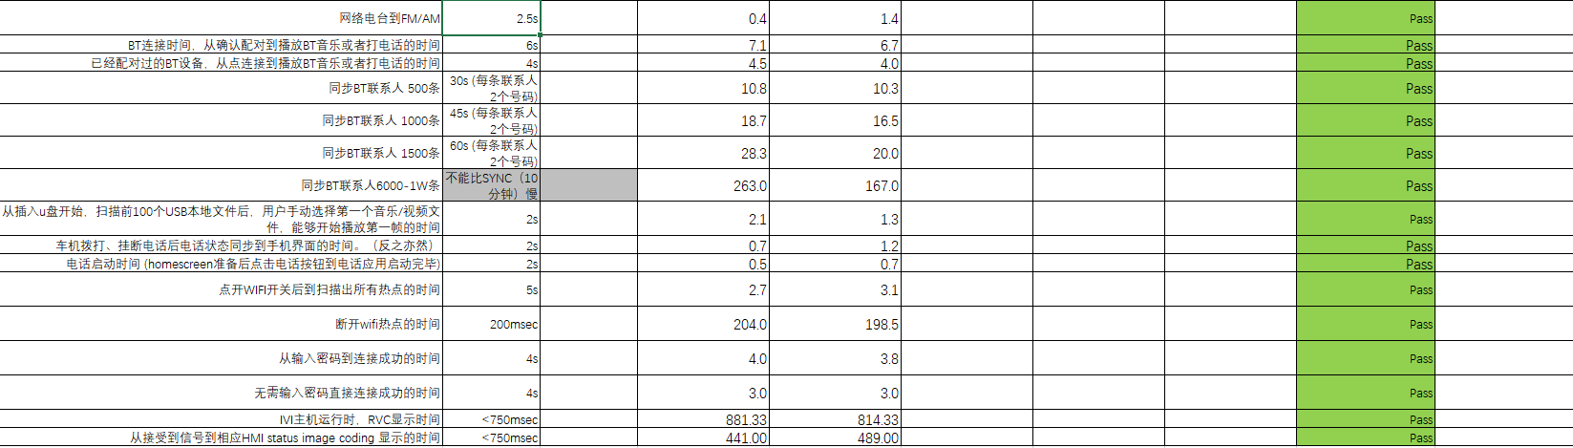
{R11 PRO HF4} 性能测试状态
Notes:
Add P1 weekly burn down chart

Slide 9
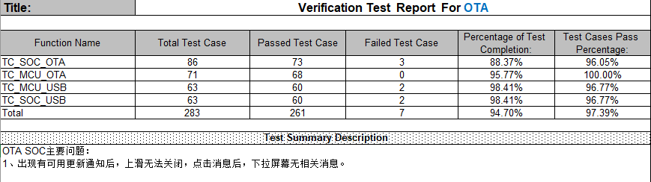
{R11 PRO HF4} OTA测试状态
Notes:
Add P1 weekly burn down chart

